Slide 1
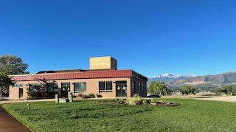
Watch our Live Services
Sunday @ 10:30 am MT
Wednesday @ 7:00 pm MT

